Slide 1
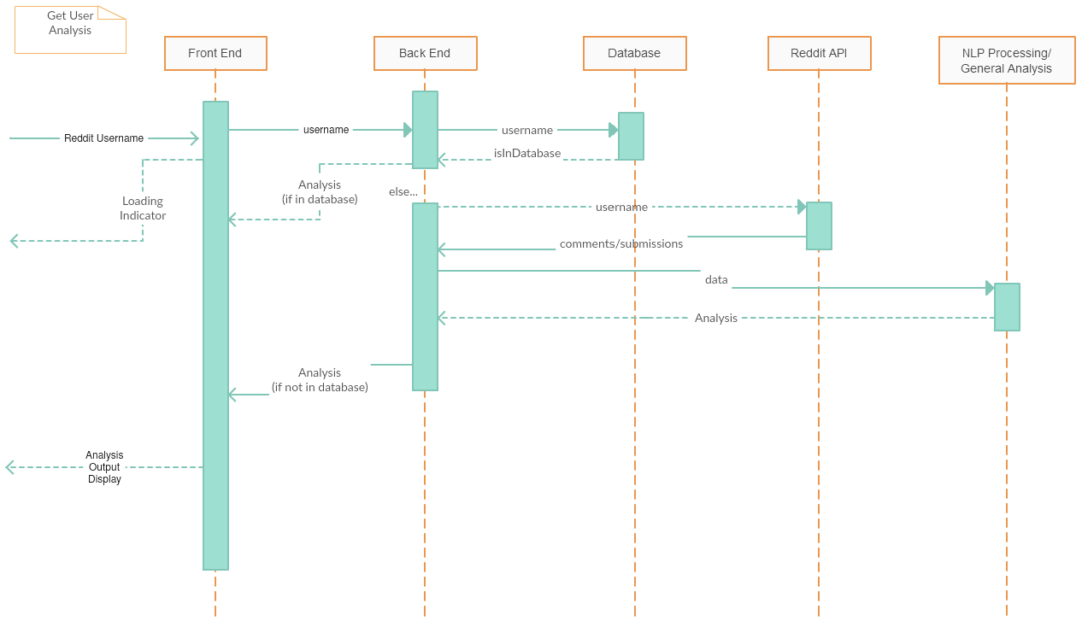
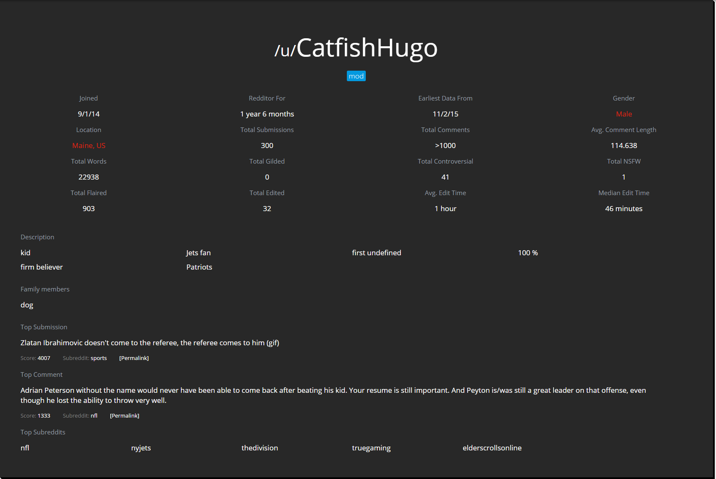
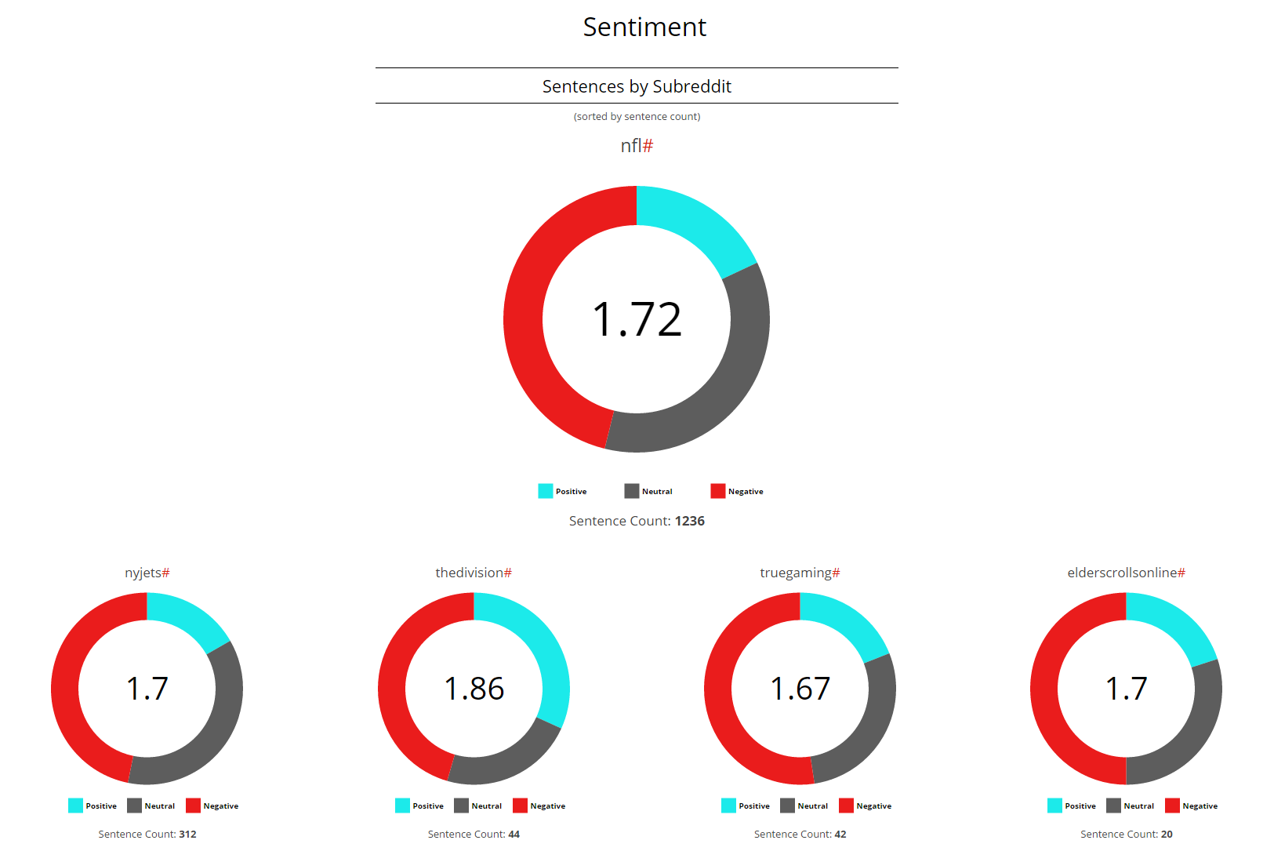
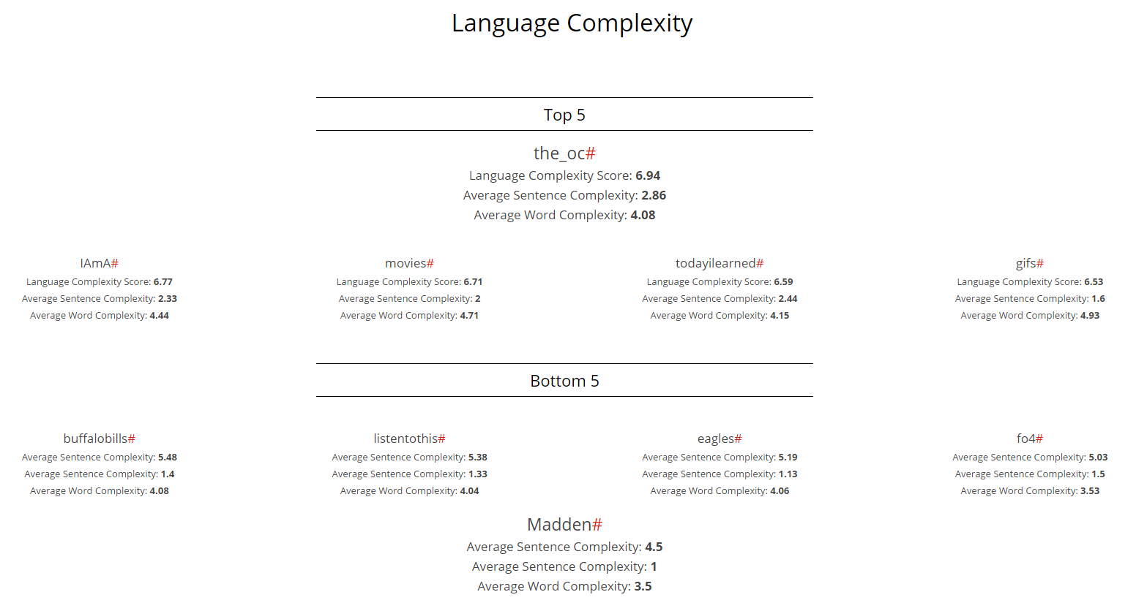
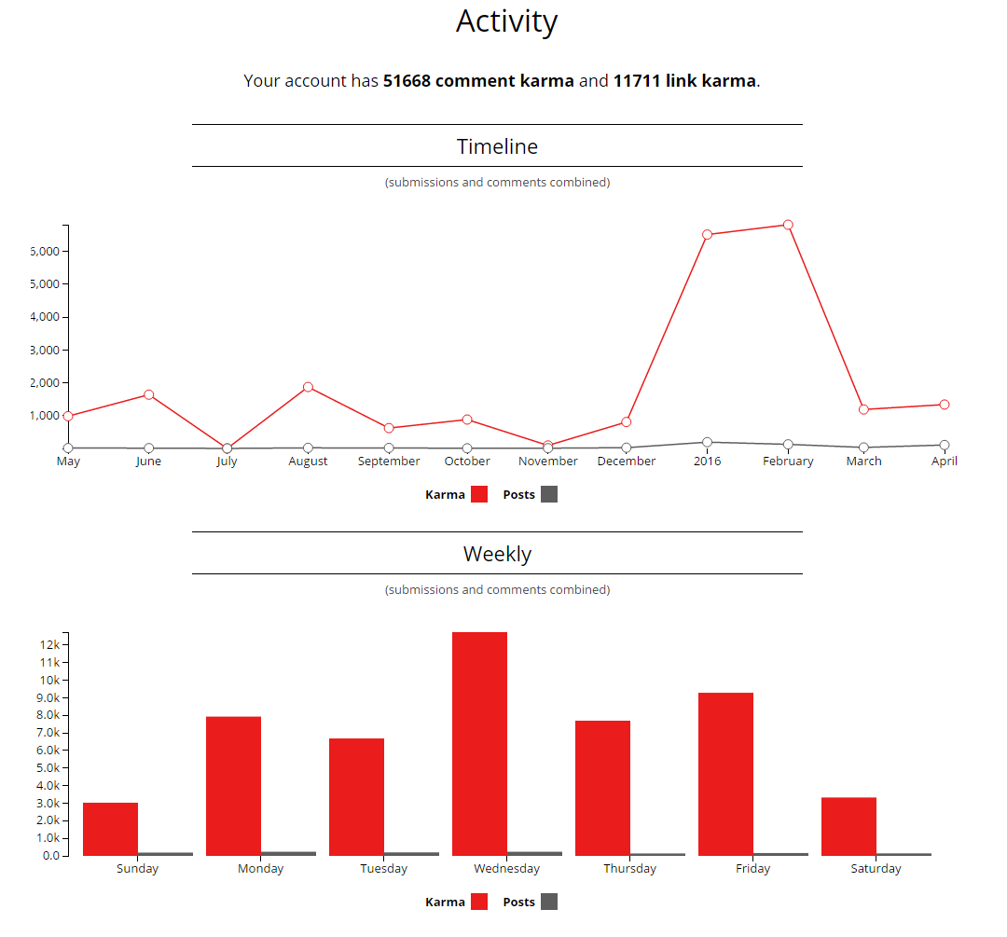
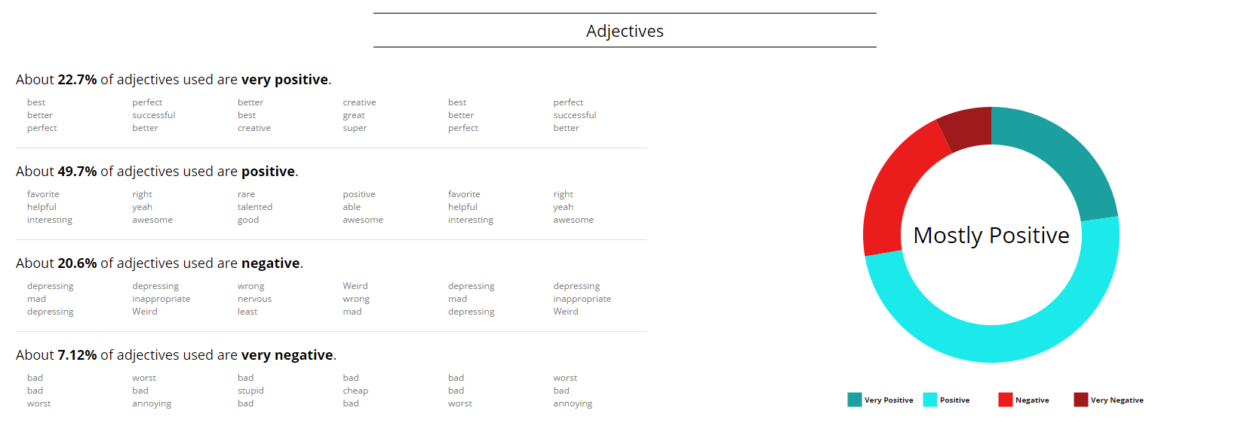

RedReaper
Julian Esteban, Kanav Tahilramani, Matthew Chatten, Sujay Bandarpalle
{jme136, kt295, mwc70, sb1073}@scarletmail.rutgers.edu
Advisor: Dr. Shantenu Jha
Project Number: S16-036
Project Overview
Methodology
RedReaper is a social media analysis tool built specifically for Reddit^{[1]}, a community website organized into “subreddits” dedicated to individual topics, where users vote on, comment on, and post what interests them.
Submissions, comments, and user histories are all publicly available to anyone, so RedReaper makes use of Reddit’s open API to gather this data on requested users or subreddits. That data is then organized, parsed, and analyzed in order to build a full report.
General Software Practices
RedReaper runs on the MEAN stack, a Javascript framework for web applications which uses mongoDB, Express, AngularJS, and NodeJS.
The project was organized on a public Github^{[3]} repository. Special care was taken to ensure that the software is extensible, allowing for individual team members to contribute their own features harmoniously.
In the early stages, the team worked together to outline goals and build the framework of RedReaper. Afterwards, each member concentrated on their area of strength, like front end display or NLP analysis.
General UML Sequence Diagram
Motivations and Objectives
Motivations
Make interesting, informative data and analysis available
Show users what can be revealed about them and their online communities through natural language processing and collated public data
Objectives
Build accurate, readable feature outputs for analysis
Provide wide variety of results, based on both content and metadata retrieved
Results
Challenges
Deciding on best framework for project
Chose to build a website using the MEAN stack
Figuring out best approach for natural language processing
Chose to use Stanford open source NLP tools^{[2]} for our own custom analyses
Make improvements to performance
Chose to use ample processing power, reduce database storage, and increase efficiency of API calls and NLP processing
Acknowledgement
References
We would like to thank our advisor, Dr. Jha, and all those who create, maintain, and document the open source tools and extensions that make projects like this possible. Many thanks.
[1] "We Power Awesome Communities." Reddit.com: About Reddit. N.p., n.d. Web. 19 Apr. 2016. <https://www.reddit.com/about/>.
[2] “The Stanford Natural Language Processing Group.” Stanford. N.p., n.d. Web. 19 Apr. 2016. <http://nlp.stanford.edu/software/>.
[3] "Vanak/red-reap." GitHub. N.p., n.d. Web. 19 Apr. 2016. <https://github.com/vanak/red-reap>.

